Slide 1
Adaptive Formation Control of Robot Swarms using Optimized Potential Field Method
2017 IEEE
Basma Gh. Elkilany ∗, A. A. Abouelsoud ∗† and Ahmed M.R. Fathelbab ∗‡
∗Mechatronics and Robotics Engineering Department, School of Innovative Design Engineering,
Egypt-Japan University of Science and Technology (E-JUST)
New Borg Al-Arab city, Alexandria, Egypt

Slide 2
introduction
Robot Swarm
Potential Field Method
Artificial Neural Network
Experimental Result
Conclusion

Slide 3
Robot Swarm
Keep in a particular formation
Avoid collision with obstacles in the environment
Track a certain trajectory

Slide 4
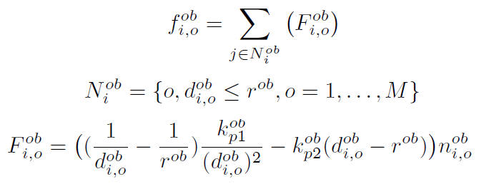
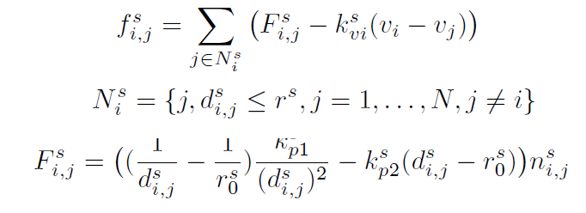
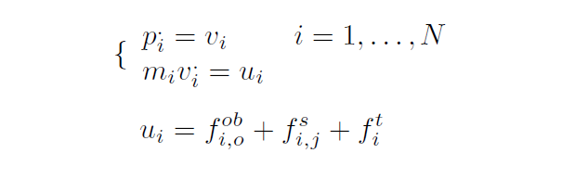
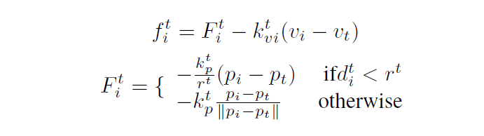
Potential Field Method
Obstacle Potential Field
Swarm Potential Field
Target Potential Field

Slide 5
Artificial Neural Network
INPUT : Distances between robots in the swarm, distances between robots and obstacles and the distances between robots and the trajectory
OUTPUT : Distances between robots and the trajectory

Slide 6
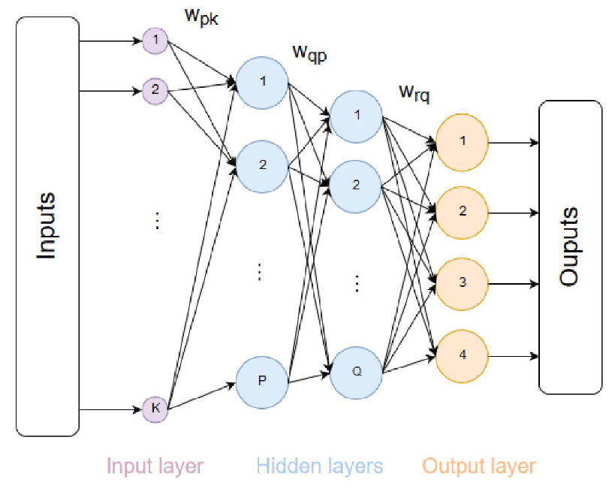
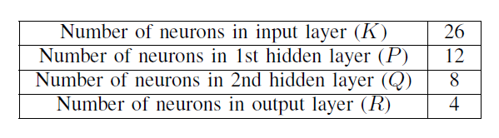
Artificial Neural Network
Activation function
Hidden neurons are sigmoid
Output neurons are linear
Back-propagation learning algorithm updates the weights
Error represents how the robot is far from the target trajectory

Slide 7
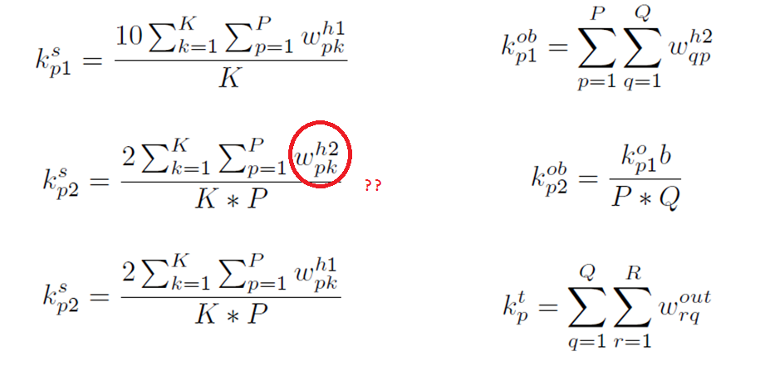
Artificial Neural Network

Slide 8
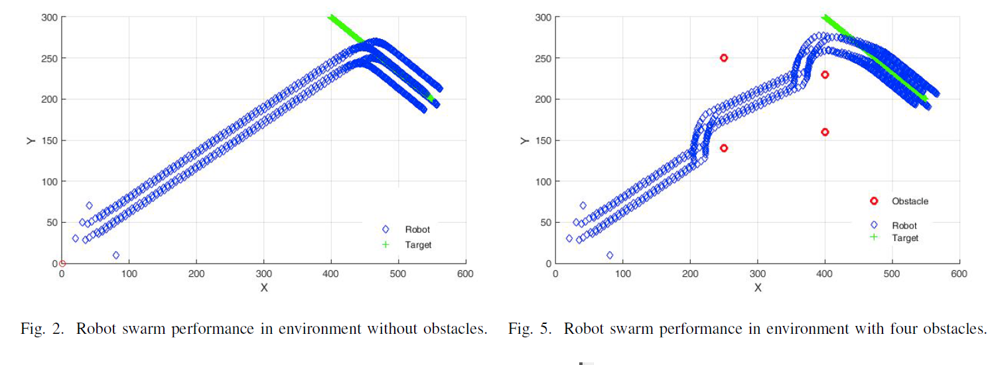
Experimental Result

Slide 9
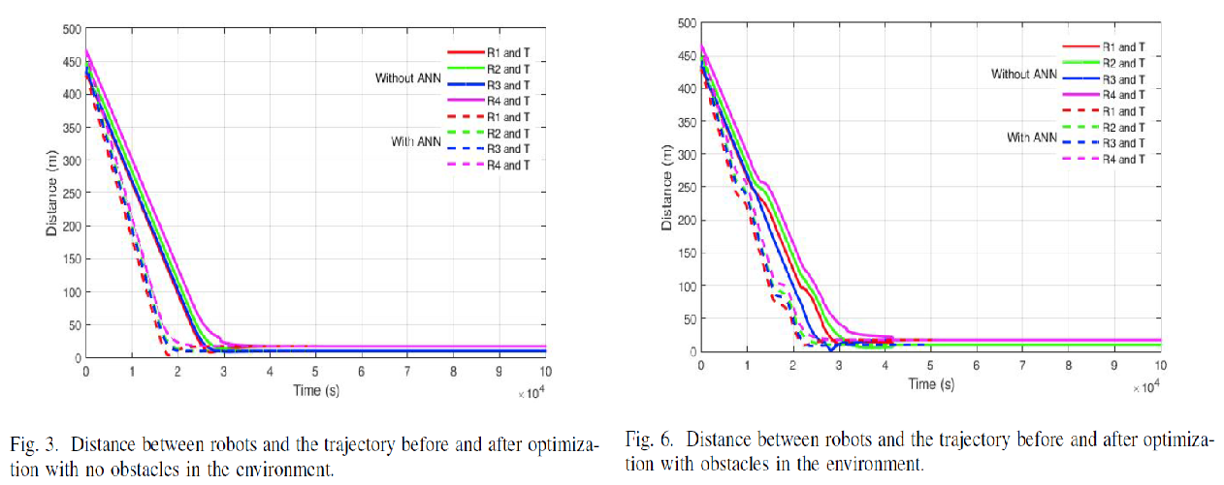
Experimental Result

Slide 10
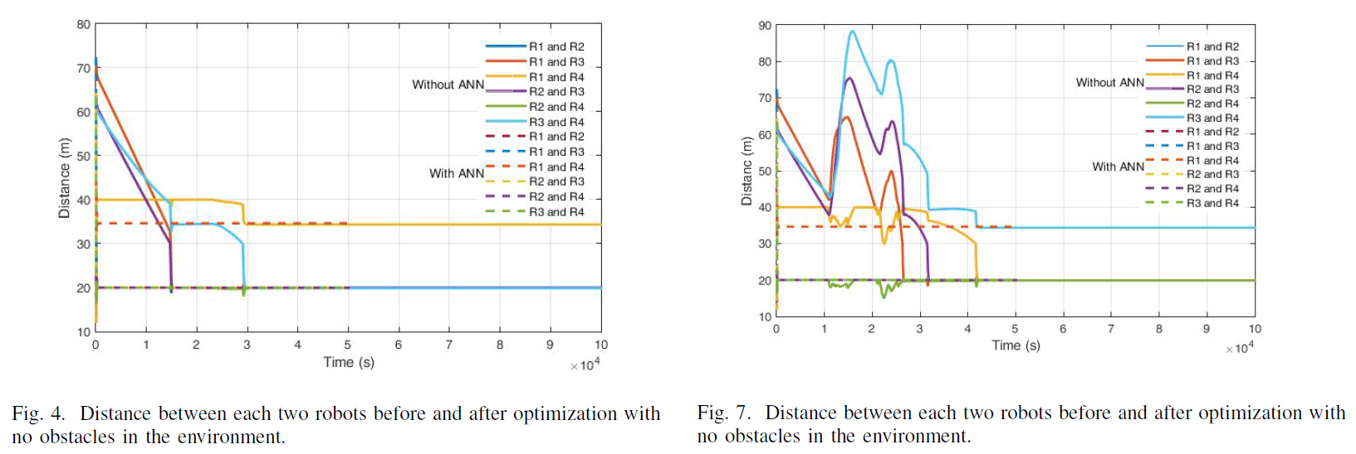
Experimental Result

Slide 11
Conclusion
Robot Swarm’s performance is improved by Aritificial Neural Network

